Slide 1

Vishnu Devineni
Bharath Kondreddy
Vaishnavi pandala

Slide 2

Emotion Recognition Using AI

Slide 3

INTRODUCTION
Human facial expressions can be easily classified into 7 basic emotions: happy, sad, surprise, fear, anger, disgust, and neutral.
Our facial emotions are expressed through activation of specific sets of facial muscles. These sometimes subtle, yet complex, signals in an expression often contain an abundant amount of information about our state of mind.
Humans are well-trained in reading the emotions of others, in fact, at just 14 months old, babies can already tell the difference between happy and sad. But can computers do a better job than us in accessing emotional states?

Slide 4
Objective:
Emojis are small digital images used to express an idea or emotion in electronic communication and have become very popular in recent years.
The introduction of smartphones in 2001 played a key role in the adoption of emojis.
Emojis have become an integral part of digital communication and serve as nonverbal cues for expressing emotions or feelings.
Emojis are used in a variety of contexts, including emotion recognition, online communication, brand marketing, and product reviews.
Advances in computer vision and deep learning have made it possible to detect human emotions from photos and classify them to map corresponding emojis or avatars.

Slide 5






FACIAL EMOTIONS
ANGRY
SAD
SURPRISE
FEAR
NEUTRAL
HAPPY

Slide 6
Approach
A deep learning model will be created to classify facial emotions in photographs.
The model will then be used to locate an appropriate avatar or emoji based on the defined emotion.
The dataset used for this project is FER2013, which consists of grayscale face images that are 48*48 pixels in size.
The FER2013 dataset is specifically designed for facial expression recognition.
By training a deep learning model on this dataset, it will be possible to accurately classify facial expressions and associate them with appropriate emojis or avatars.

Slide 7

LIBRARIES USED:
Pandas
Numpy
CV2
datetime
Tensorflow
Tkinter
OS
Seaborn
Matplotlib

Slide 8

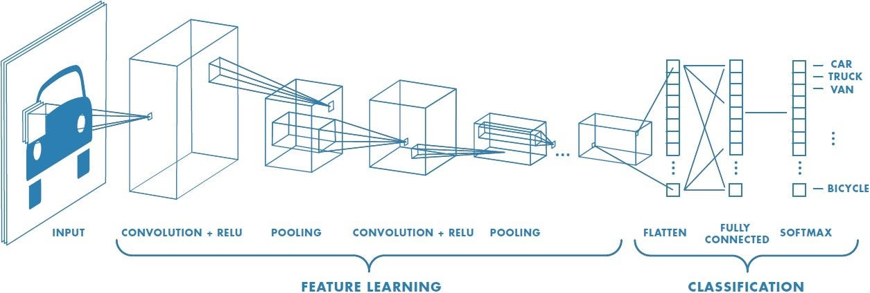
convolutional neural network
In deep learning, a convolutional neural network (CNN) is a class of deep neural networks, most commonly applied to analyze visual imagery.
Convolutional neural networks are composed of multiple layers of artificial neurons.
Artificial neurons, a rough imitation of their biological counterparts, are mathematical functions that calculate the weighted sum of multiple inputs and outputs an activation value.
When you input an image in a ConvNet, each layer generates several activation functions that are passed on to the next layer.

Slide 9
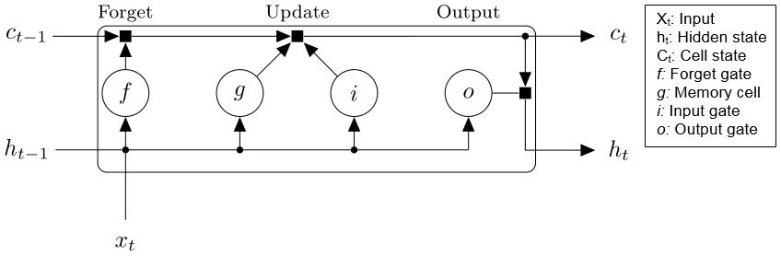
Long short-term memory (LSTM)
Long short-term memory (LSTM) is an artificial neural network used in the fields of artificial intelligence and deep learning.
LSTM networks use additional gates to control what information in the hidden cell is exported as output and to the next hidden state . The additional gates allow the network to learn long-term relationships in the data more effectively.
In addition to the hidden state in traditional RNNs, the architecture for an LSTM block typically has a memory cell, input gate, output gate, and forget gate

Slide 10
DELIVERABLES
A convolutional neural network (CNN) and Long Short Term Memory(LSTM) model will be developed for recognizing facial emotions.
The FER2013 dataset will be used to train the CNN model.
Once the model is trained, each facial emotion will be associated with the appropriate emoji or avatar.
Sample output images will be generated to demonstrate the accuracy of the model.
All documentation and code for the project will be available in a GitHub repository.
A YouTube video will be created to showcase the project and its capabilities.

Slide 11
Evaluation Methodology:
The evaluation methodology for the project involves data preparation, development of a CNN model, training and testing the model, mapping facial emotions to appropriate emojis, evaluating performance metrics, generating sample output images, creating a GitHub repository with code and documentation, and showcasing the project through a YouTube video.

Slide 12
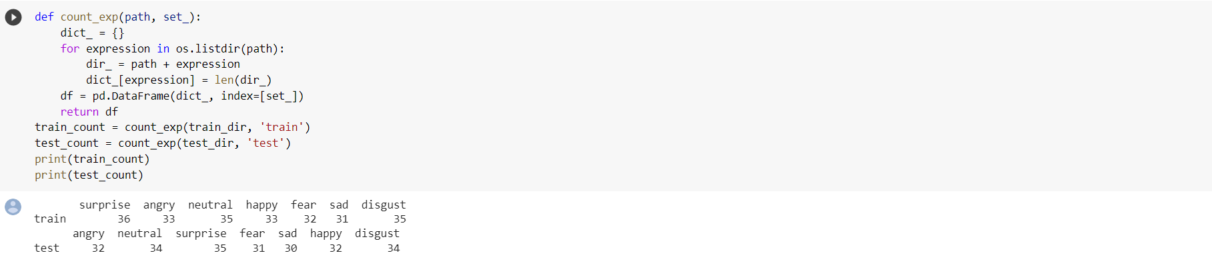
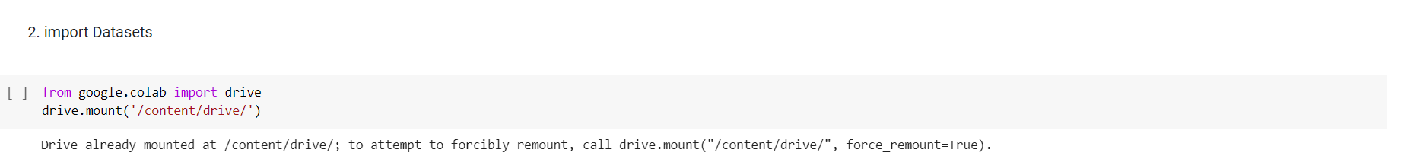
CODE SNIPPETS

Slide 13
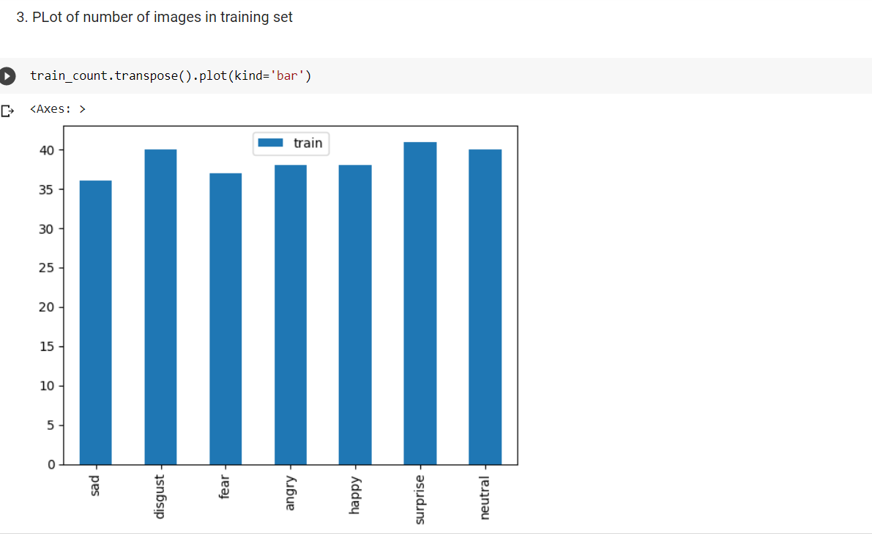
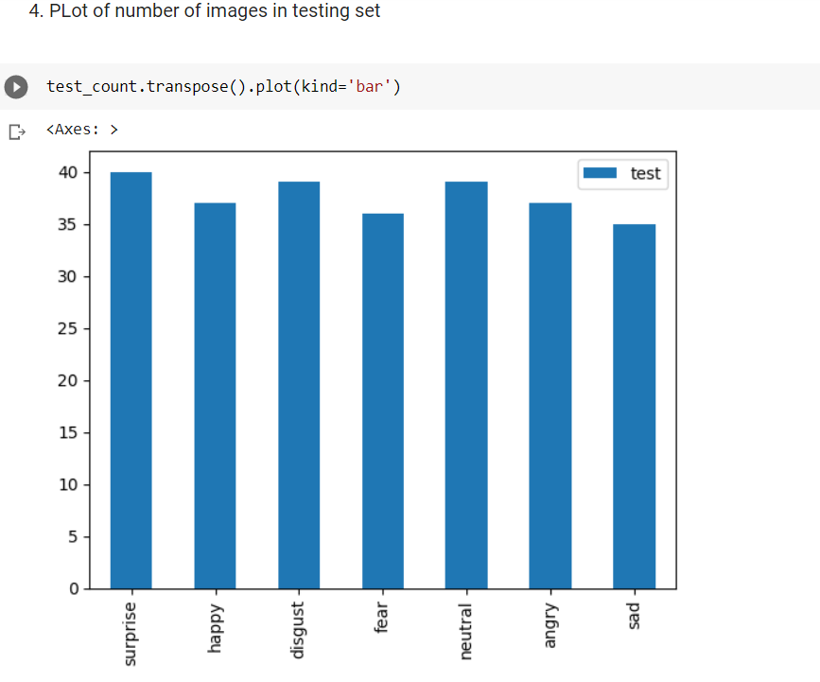

Slide 14
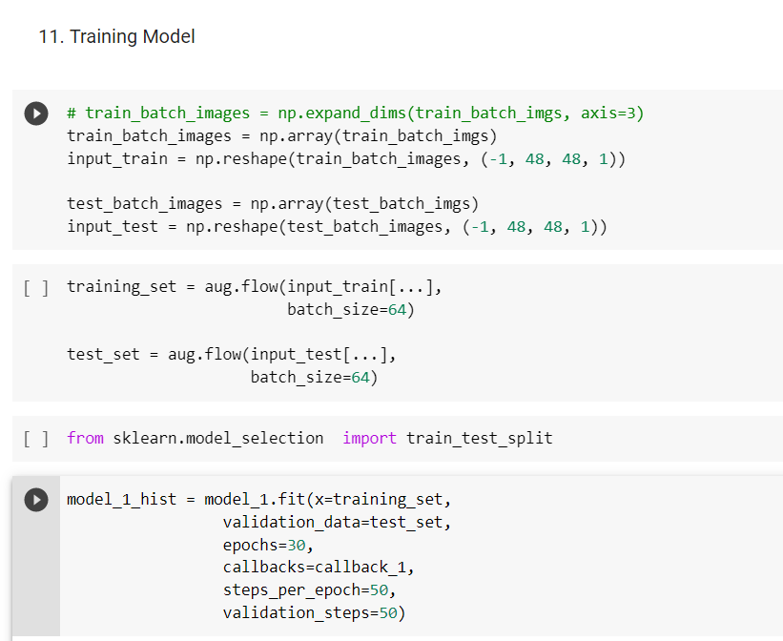

Slide 15
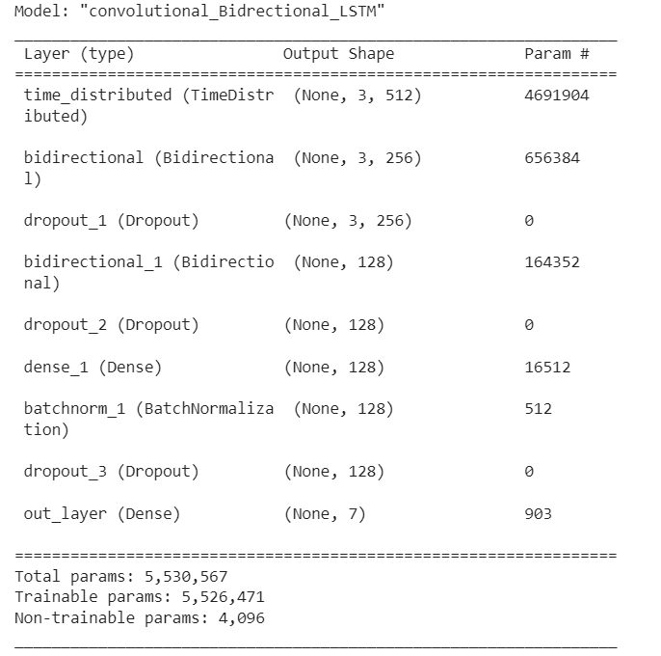

Slide 16
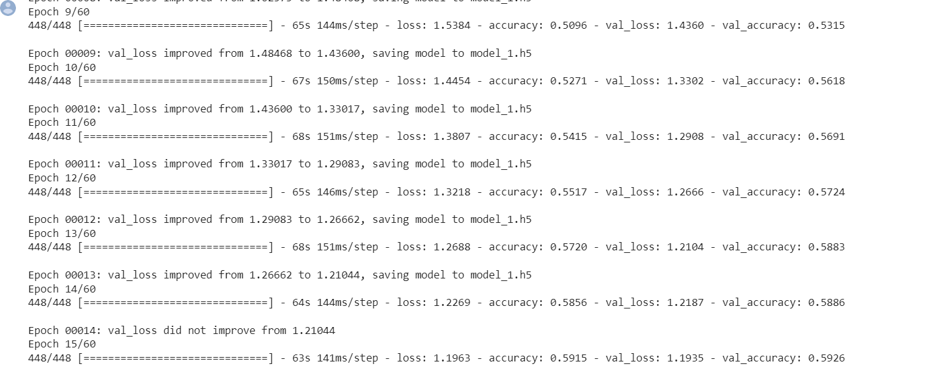


CNN ACCURACY

Slide 17
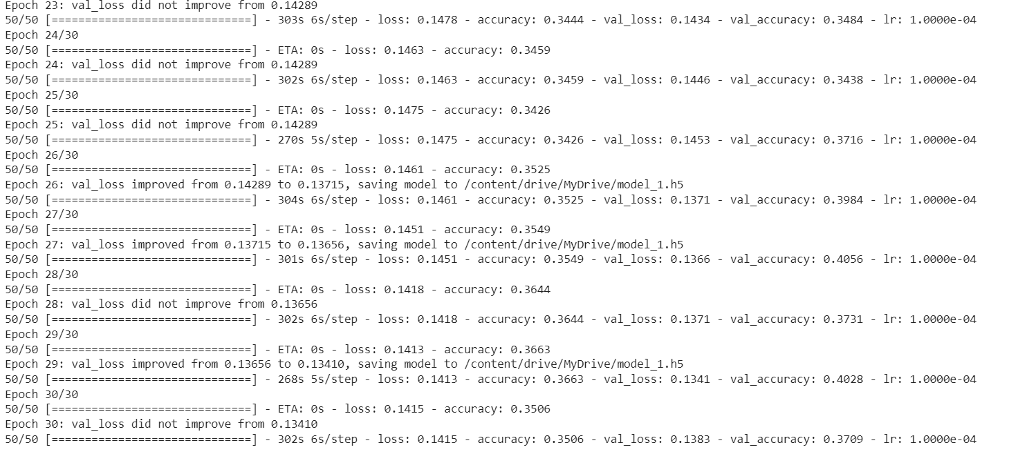

LSTM ACCURACY:

Slide 18
COMPARISION OF CNN LSTM
Both CNN and LSTM can be used for emotion detection tasks, but they have different strengths and weaknesses.
CNNs are good at processing image data because they can capture spatial information from the image and learn complex features. They are commonly used in computer vision tasks, including emotion detection from images.
LSTMs are good at processing sequential data because they can capture temporal dependencies and learn from the sequence of inputs. They are commonly used in natural language processing tasks, including emotion detection from text.
So, if you are working with image data, CNNs may be a better choice for emotion detection, while if you are working with text data, LSTMs may be more suitable. However, the best approach ultimately depends on the specifics of your task and the nature of your data.

Slide 19
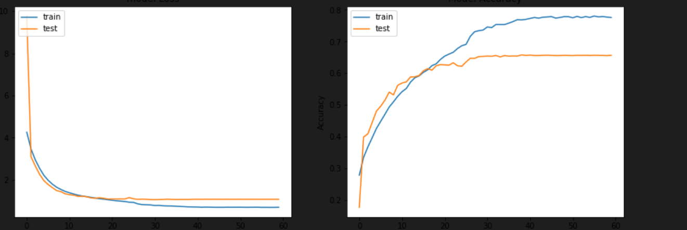
LOSS AND ACCURACY PLOT

Slide 20

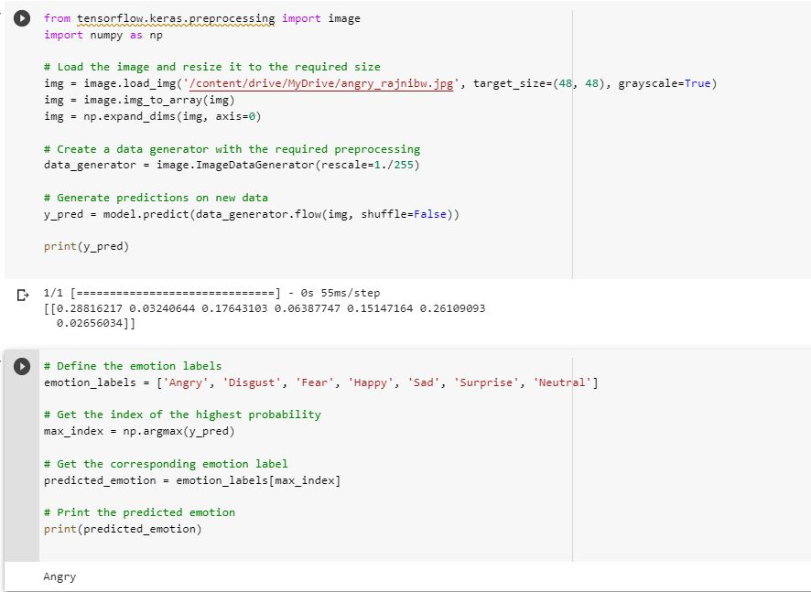


RESULTS

Slide 21
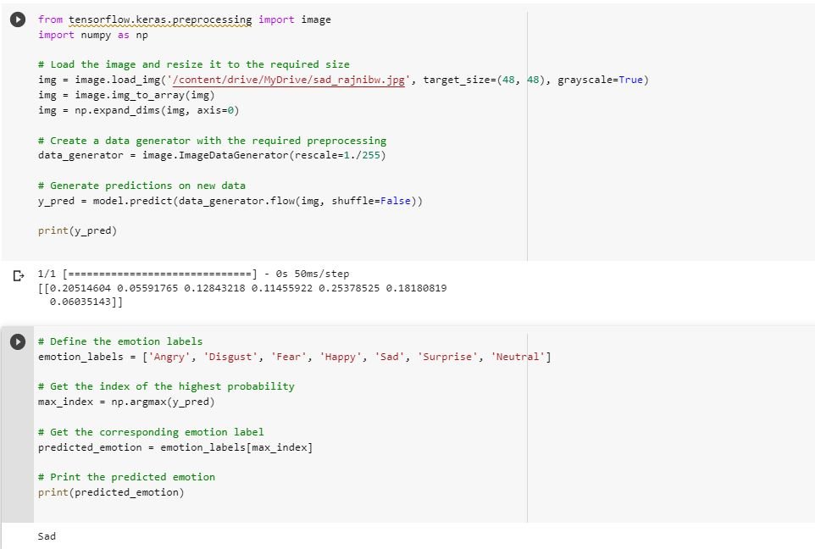
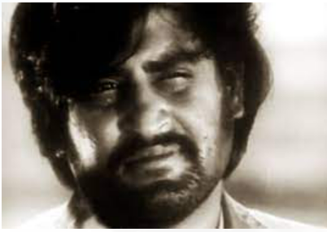


RESULTS

Slide 22
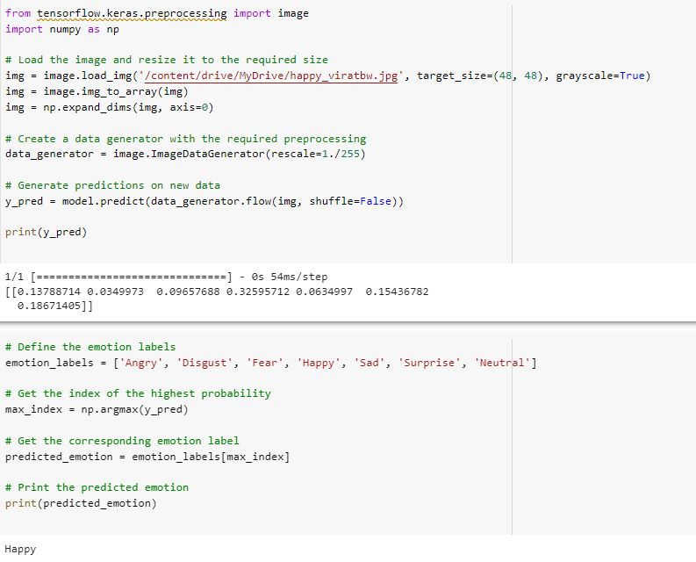


RESULTS

Slide 23
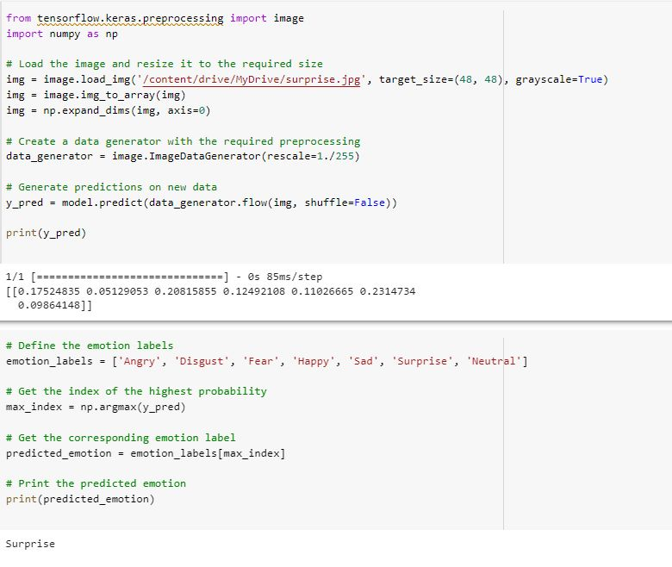
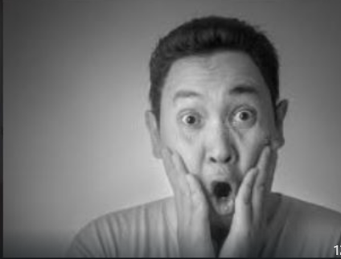


RESULTS

Slide 24
Thank You

